Slide 1

WeBer
NOVEMBER 2022

Slide 2

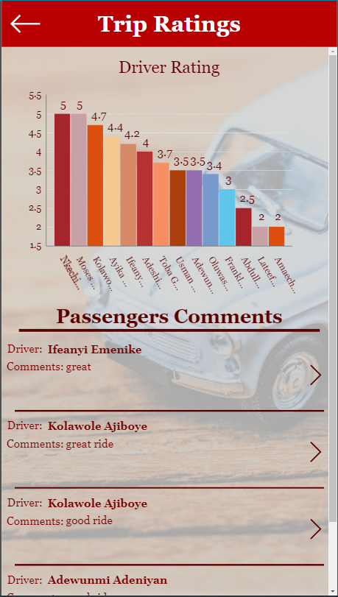
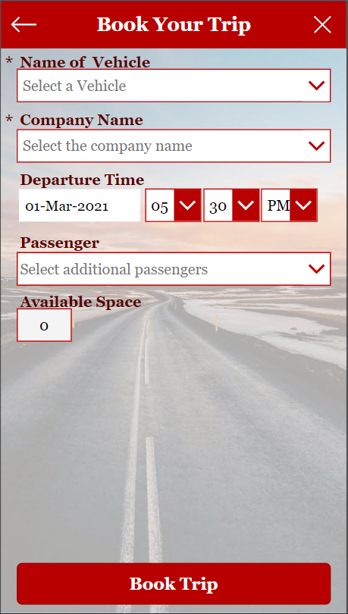
Why WeBer ?
Pool vehicles are becoming increasingly
important in the vehicle fleet. Companies are
increasingly turning to carpooling in order to:
optimize fleet utilization,
cut costs and
maximize company vehicle access to as many employees as possible.
Also, Tracking car Expenses helps in forecasting
and budgeting Fleet expenses

Slide 3

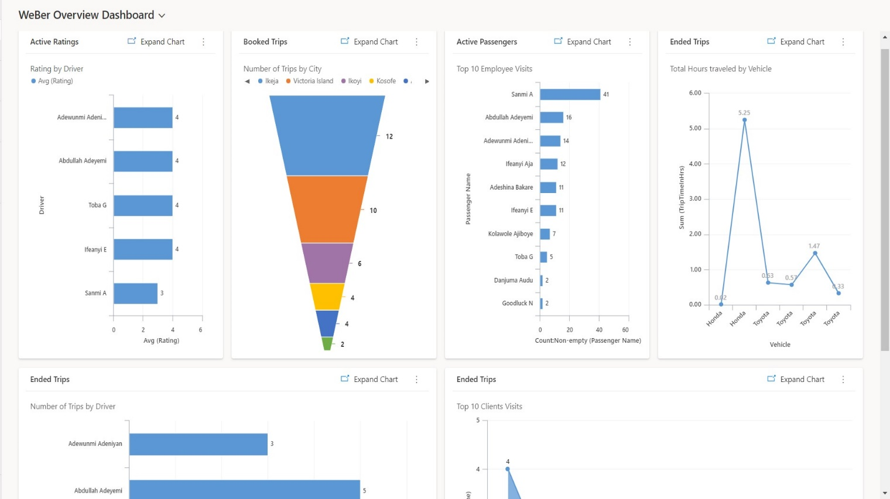
Benefits of WeBer
Allows organization fully to utilize the features on Microsoft 365
Analytics that show all ratings that have been given to drivers
Empowers drivers to be digitally savvy by allowing them to start and end trips
.
Improves utilization of organizations’ fleet of cars
Increases employee engagement as it transforms commuting to social experiences
Gives employees real-time updates on where their colleagues are
Organizations utilize the drivers adequately

Slide 4
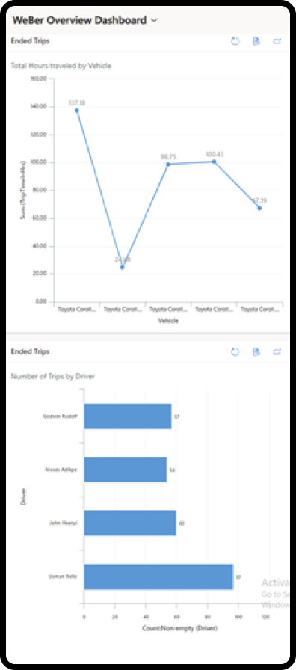
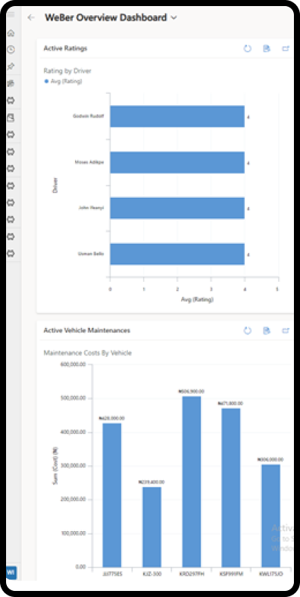
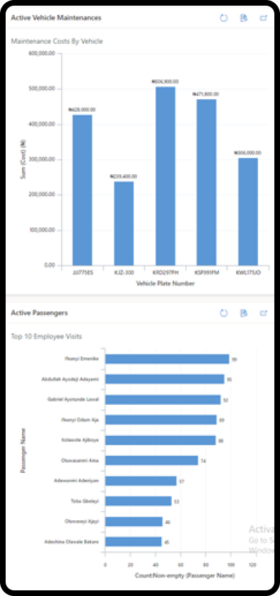
Quick View of Fleet Analytics
At a single glance, WeBer analytics dashboard
provides admins with real-time data and insights
on fleet operations
Access information on :
drivers’ ratings
booked trips
completed trips
active passengers and
more

Slide 5
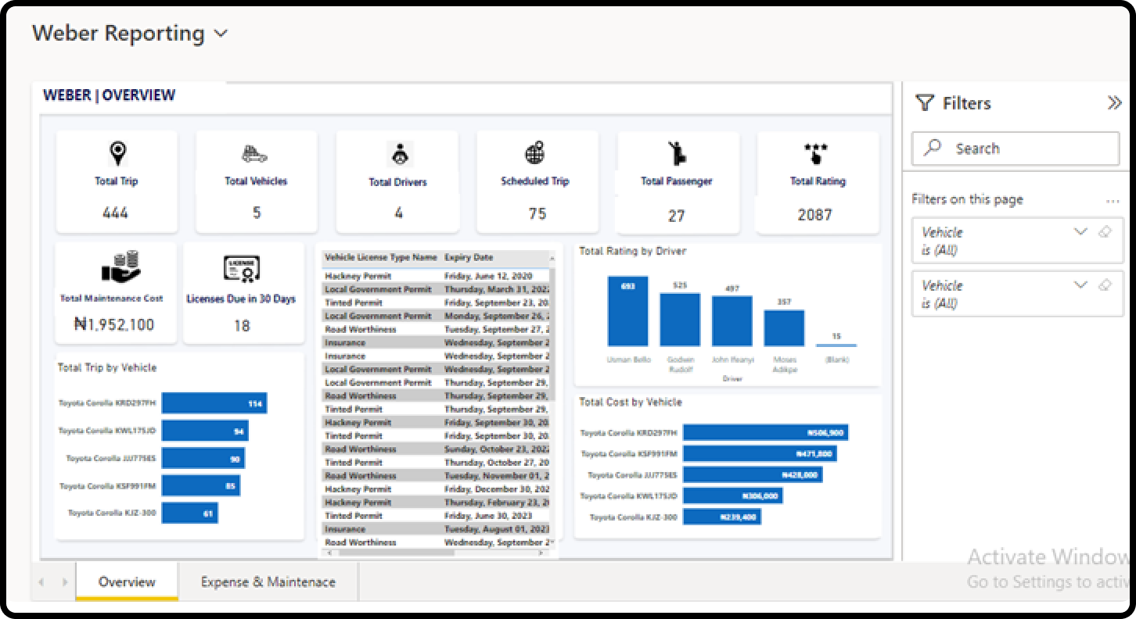
Transforming a business can be challengeing
Quick View of Fleet Analytics
View all fleet characteristics
Total Vehicles
Drivers
Total Trips
Total Maintenance cost
Vehicle and driver license expiration
dates

Slide 6
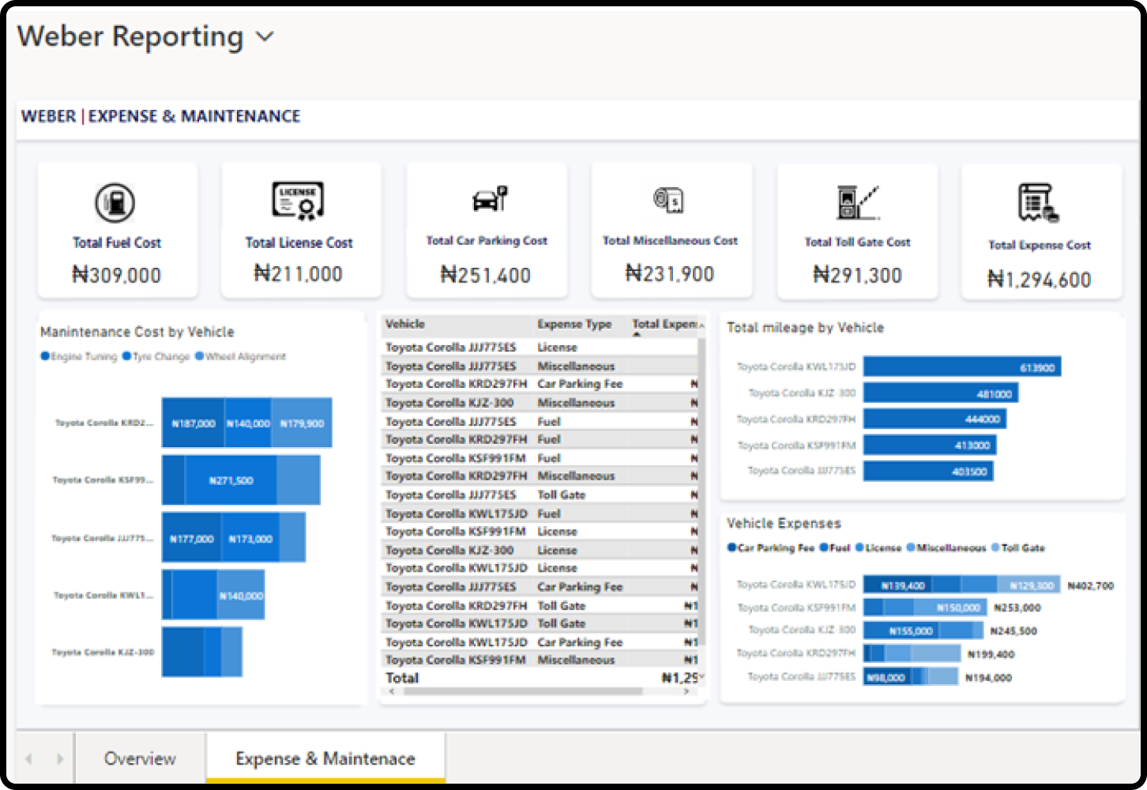
Quick View of Fleet Analytics
View all fleet characteristics
Total Fuel cost
Total license cost
Maintenance cost per vehicle across
different maintenance components
Total Vehicle expenses per vehicle
across different cost drivers

Slide 7
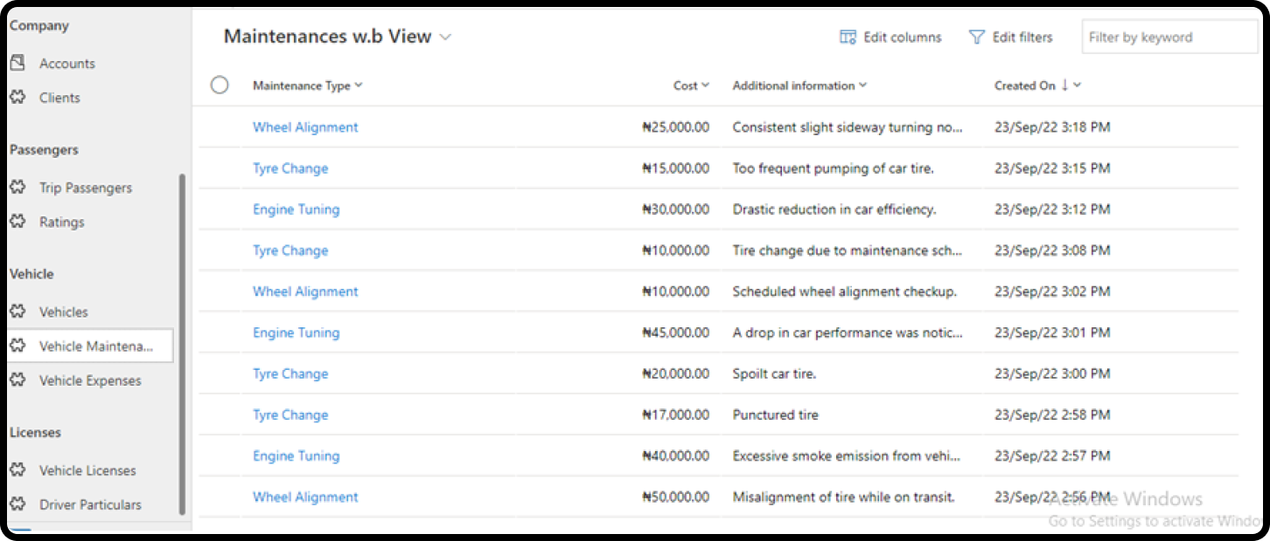
Vehicle repair/maintenance history:
Vehicular repair history section provides
a platform for managing repairs and
keeping track of repairs that have been carried out on all vehicular assets
You can:
Monitor Vehicle conditions
Plan new fleet acquisition
Observe failure trend and root
causes

Slide 8
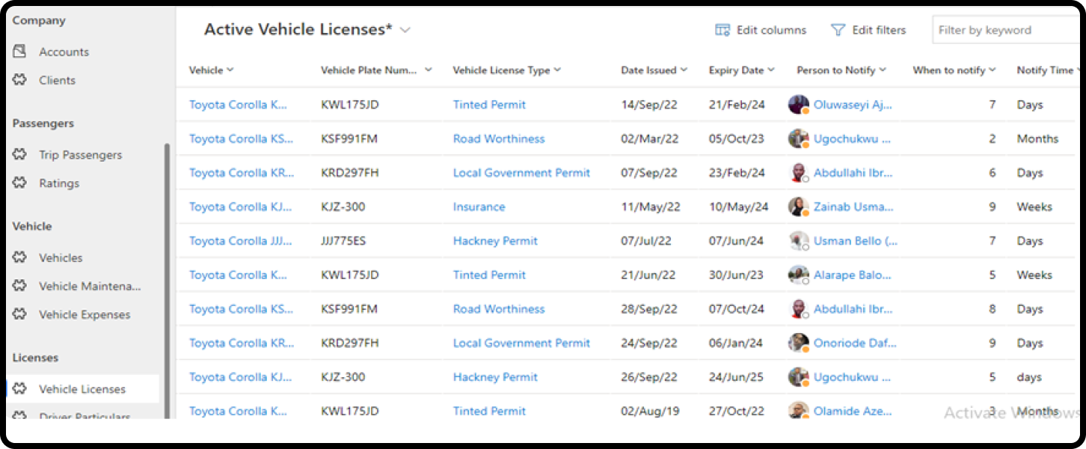
Vehicle license manager
Manage all Vehicle licenses.
Highlights:
Documents all vehicles licenses
Notifies concerned stakeholders ahead
of time to the expiration of any licenses
to ensure prompt renewal

Slide 9
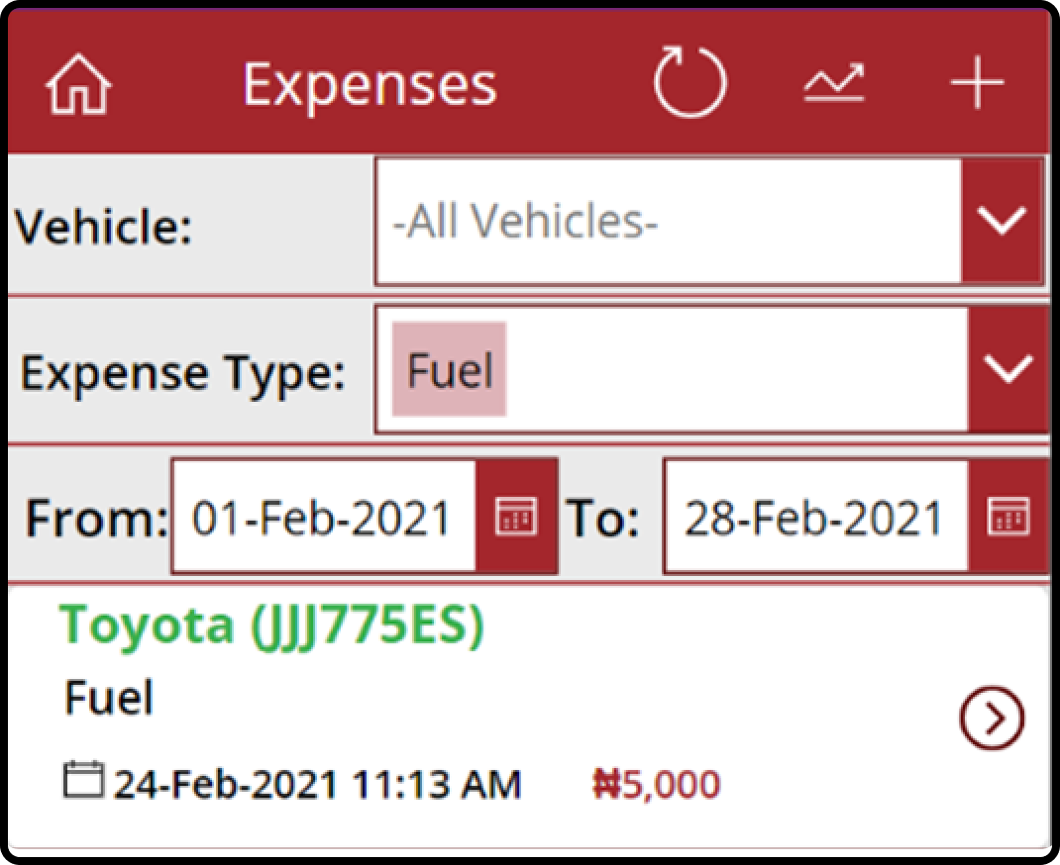
Fuel Tracking
Helps in recording fuel transactions for each of the company assets. This also gives insight and enables monitoring of fuel expenses.
Achieve :
Fuel accountability
Track vehicle fuel economy
Forecasting Fuel cost and budgeting

Slide 10
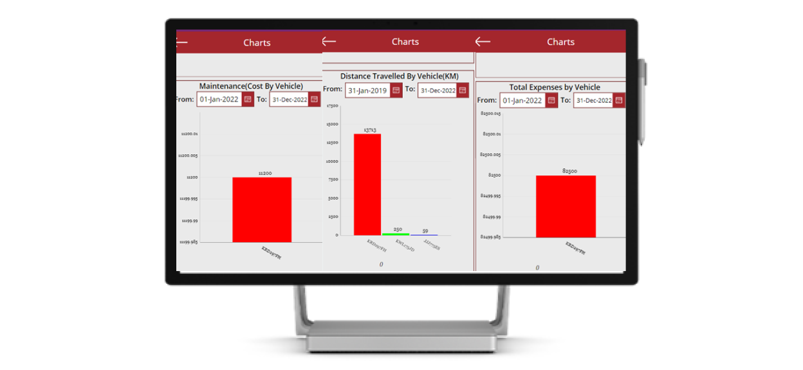
Charts/Reports
Charts and Reports are essential for every business.
With Data insights you can:
View total cost of ownership
Forestall sinking cost and decide when Vehicle has reached End of Life

Slide 11
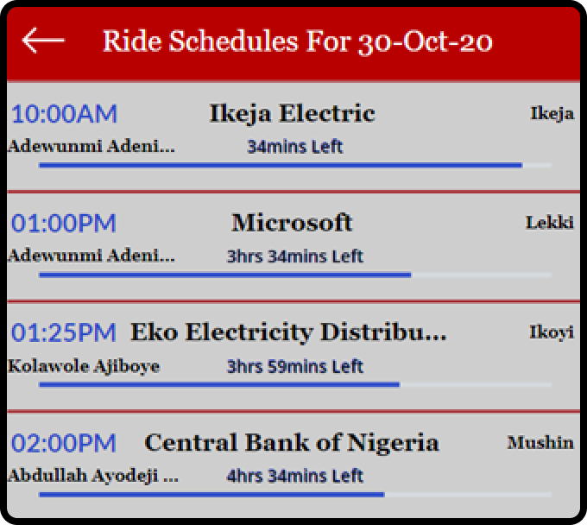
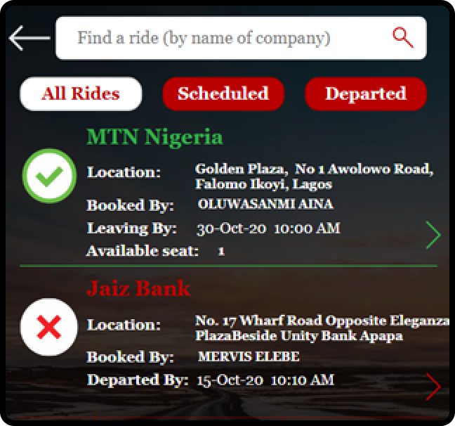
Ride scheduling feature
Employees can preplan trips and schedule on
the user application. So as to:
Reduces ride clashes
Allows for smarter planning of trips
Optimal Fleet Utilization
Better insights for Fleet manager before
trips occur

Slide 12
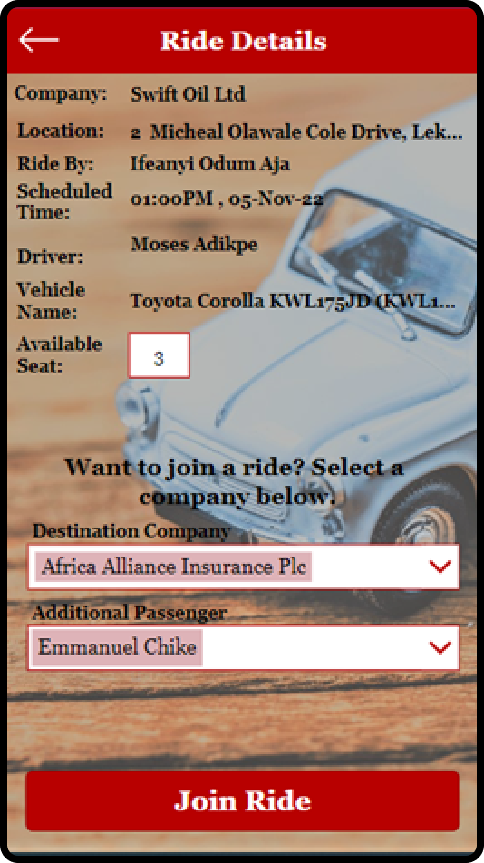
Ride Sharing
The ride sharing capability provides opportunities for employees to create connections while commuting to same or close destinations.
This helps to:
Save cost by avoiding route repetition
Reduce company’s Carbon footprint
Increase Fleet Useful life

Slide 13
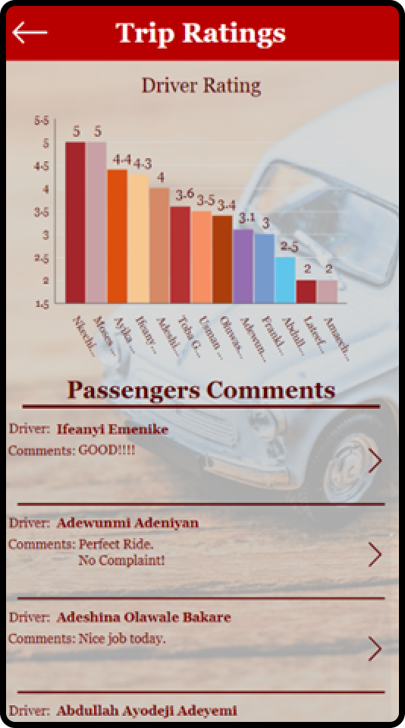
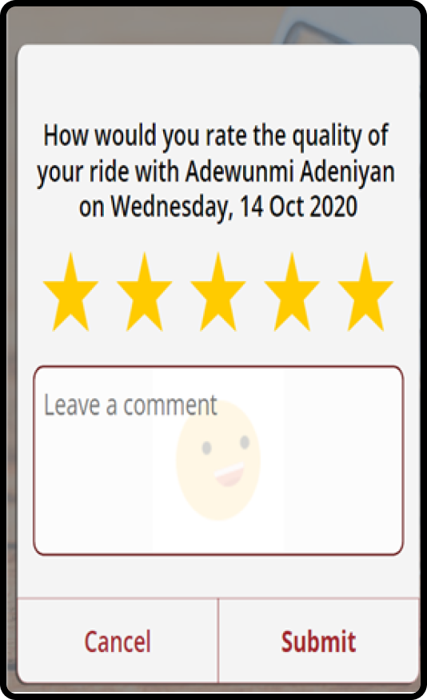
Drivers Rating
Passengers give feedback on driver performance
at the completion of any trip using this feature.
Benefits:
Track driver behavior for reward or corrections
Measure driver’s compliance to safe driving regulation

Slide 14
Thank you.

